Slide 1
Healthnet
The Procrastinators: Release 2

Slide 2

Team Members
Chris Lim - Team Coordinator
Kyle McVay - Development Coordinator
Cole Rogers - Test Coordinator
Maximillian McMullen - Requirements Coordinator
Soowon Moon - QA Coordinator

Slide 3

Table Of Contents
Project Planning
Requirements
Use Case Diagrams
Class Diagrams
Changes from R1
Results
Q/A

Slide 4
Project Planning
Incremental Design Process
  Same as R1 as it worked out for the entire group.
Weekly Project Team Meetings
  Met as frequently as we did in R1 and the work production has increased.
  More bugs as we had more code to deal with however most bugs were addressed accordingly.
Consistent Workflow
  Worked on the project consistently.
  Worked on fixing major bugs and tried to get all of functionality done.

Slide 5

Requirements
All of the Requirements from R1
Administrator Registration
Update Patient Medical Information
Export Information
Add/Remove Prescriptions
Viewing Medical information
Release Test Results
Admissions to discharge to/from hospital
Sending Messages
Upload Patient Information
Patient Transfer
Viewing System statistics

Slide 6
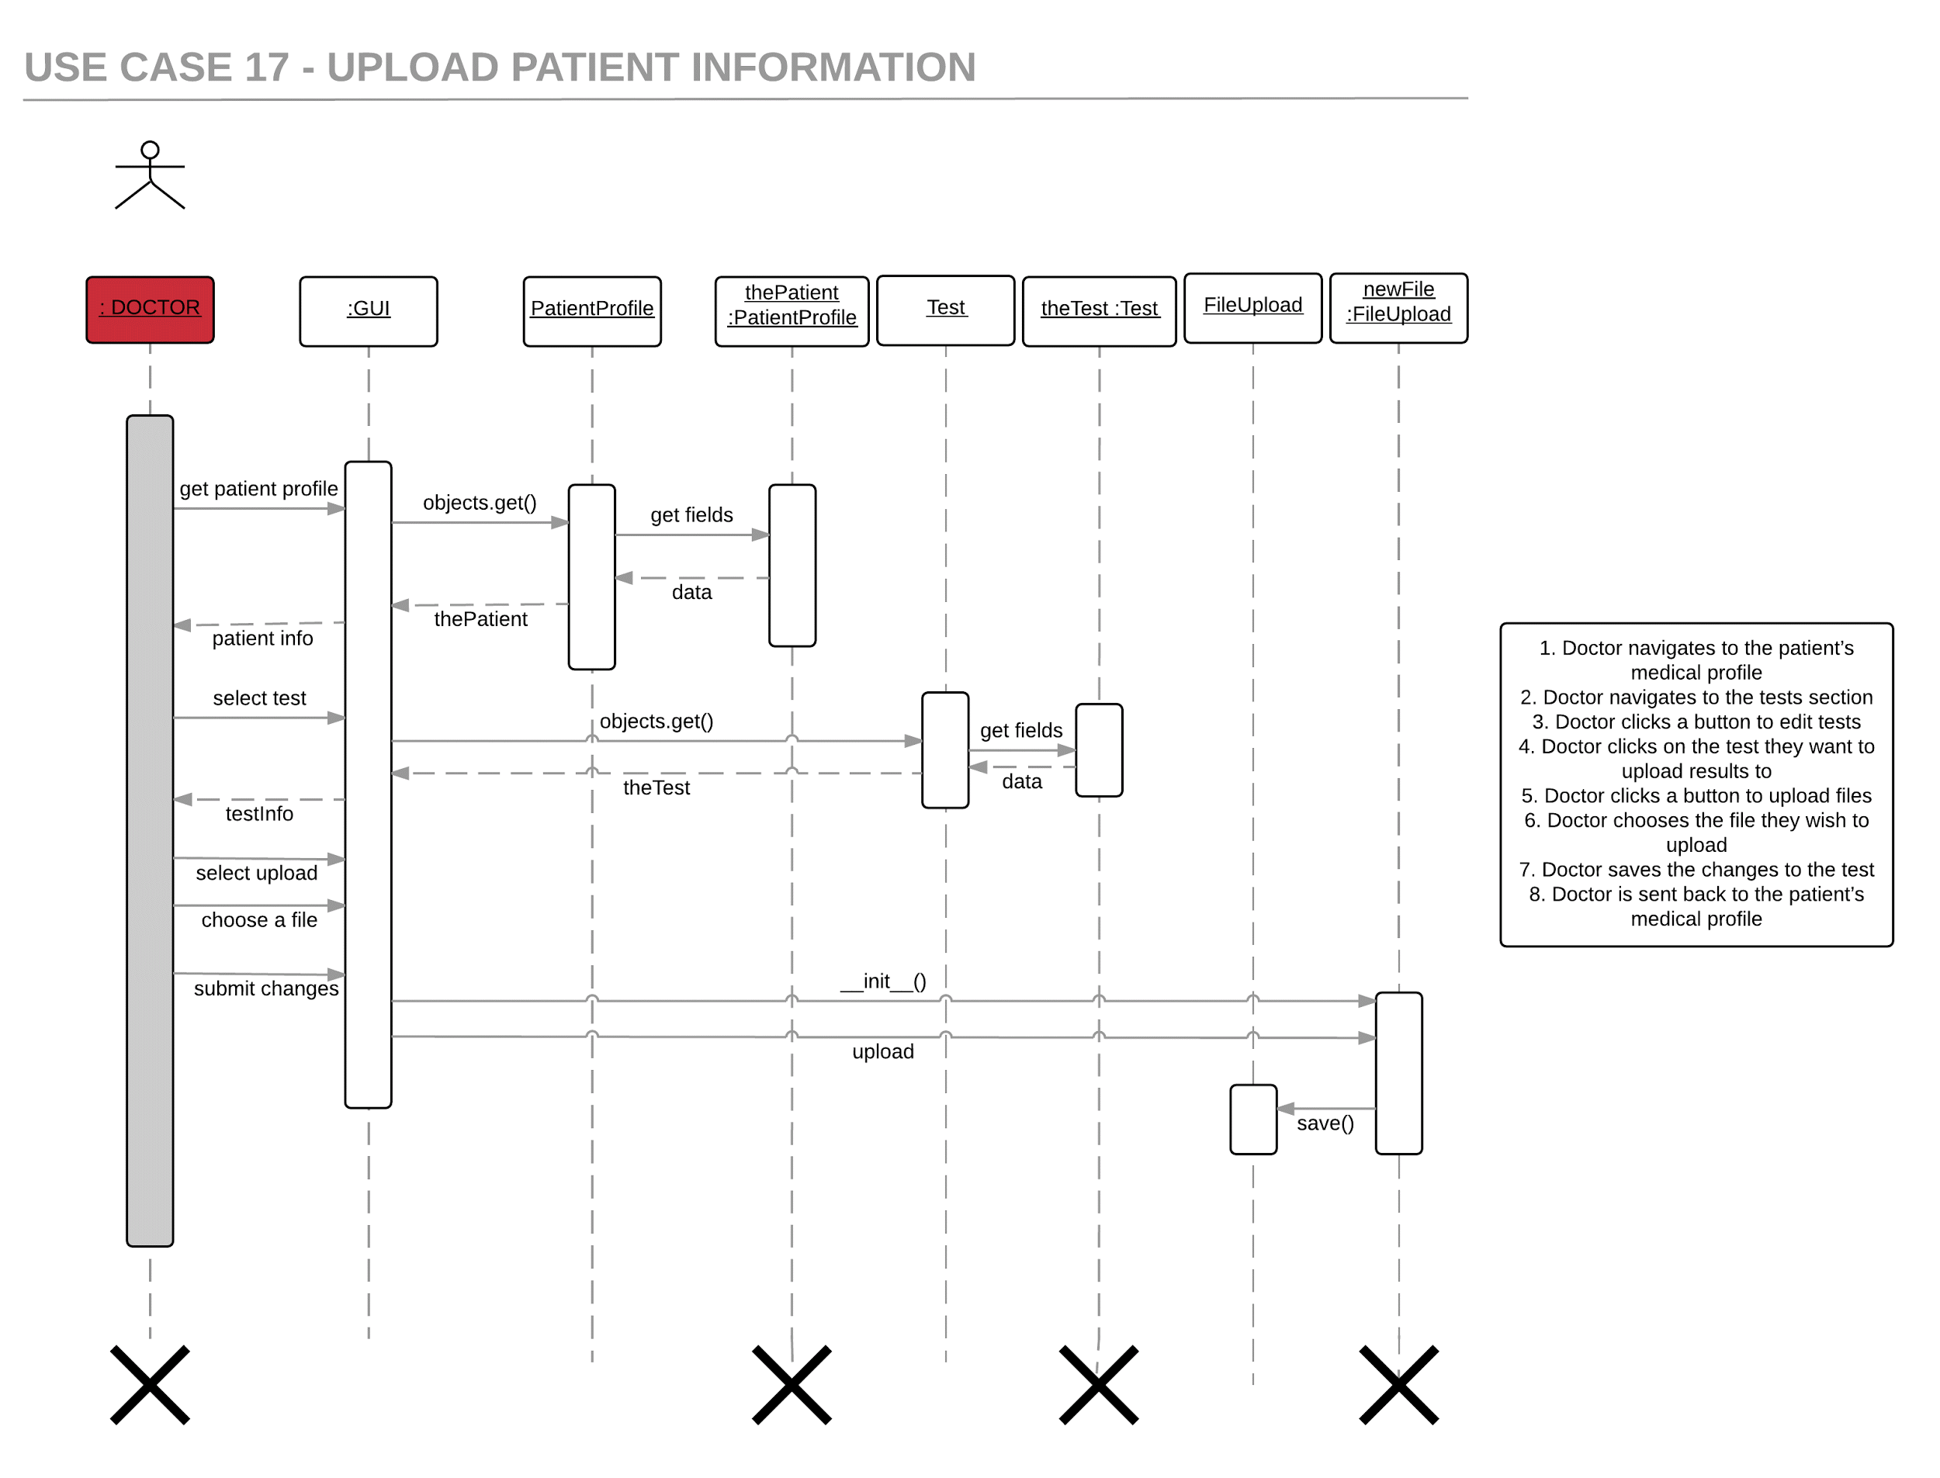

Slide 7
Changes From R1
Implementation of Bootstrap
Changing the structure of our project into a single page application with tabs.
Added more contrast and consistency for easy of use in the UI.
Focused heavily on the user side to make the project fairly presentable.
Added more functionality and refactored to prevent bugs.

Slide 8
Results
Finished all of the R2 requirements.
There may be some minor bugs in the project.
Major parts and bugs have been addressed.
Made America great.

Slide 9

Q/A

